Slide 1

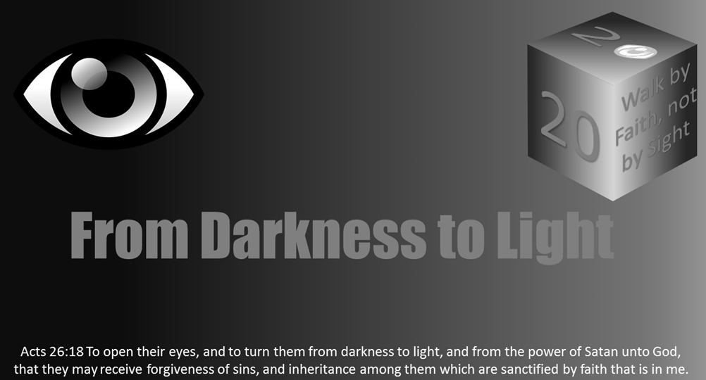



Slide 2
Doubt and Skepticism
From Darkness Lesson 7

Slide 3
“You shall not surely die.”
What if? We sometimes entertain this question as we daydream. What if we had a million dollars? What if I had a clone who could work for me so I could just relax all day? Sometimes we might pose the question to challenge our thinking or plan accordingly regarding a potential scenario. What if someone broke into the house? What if the car breaks down on my trip out West?
- Satan (Genesis 3:4)

Slide 4

Satan likes to ask “what if”…
What if there is no God?
What if the Bible is not true?
What if God does not really care about my situation?
What if I am just too sinful to save?

Slide 5
In the beginning, as quoted above, Satan cast a shadow of doubt into Eve’s heart as he modified what God had told her.
Upon entertaining the possibility that he could be right, she began to be enticed by the lust of her flesh (the tree was good for food), the lust of her eyes (it was pleasant to the eyes), and her pride (a tree desirable to make one wise). (See Genesis 3:6 cf. 1 John 2:5-7).
In the end, she ate of the forbidden fruit, and likewise Adam also ate. They sinned; despite what Satan had told them, they did die! (Rom 6:23; Isa 59:1-2)
“He [the devil] was a murderer from the beginning, and does not stand in the truth, because there is no truth in him. When he speaks a lie, he speaks from his own resources, for he is a liar and the father of it.” (John 8:44)

Slide 6
He deceives then, and he deceives now
Satan uses the same deceptions on us today that he did on
Adam and Eve (Genesis 3:6), and sadly, we often fall for them just as Adam and Eve did.
The good news, though, is that we do not have to!
In this lesson, we want to consider the remedy to doubt.
We are sure to have those “what if” thoughts from time to time, but how can we eliminate them? How can we replace our doubts with confidence?
Notes:
In the beginning, as quoted above, Satan cast a shadow of doubt into Eve’s heart as he modified what God had told her. And, upon entertaining the possibility that he could be right, she began to be enticed by the lust of her flesh (the tree was good for food), the lust of her eyes (it was pleasant to the eyes), and her pride (a tree desirable to make one wise). (See Genesis 3:6 cf. 1 John 2:5-7). In the end, she ate of the forbidden fruit, and likewise Adam also ate. They sinned; despite what Satan had told them, they did die! (Rom 6:23; Isa 59:1-2)
“He [the devil] was a murderer from the beginning, and does not stand in the truth, because there is no truth in him. When he speaks a lie, he speaks from his own resources, for he is a liar and the father of it.” (John 8:44)

Slide 7
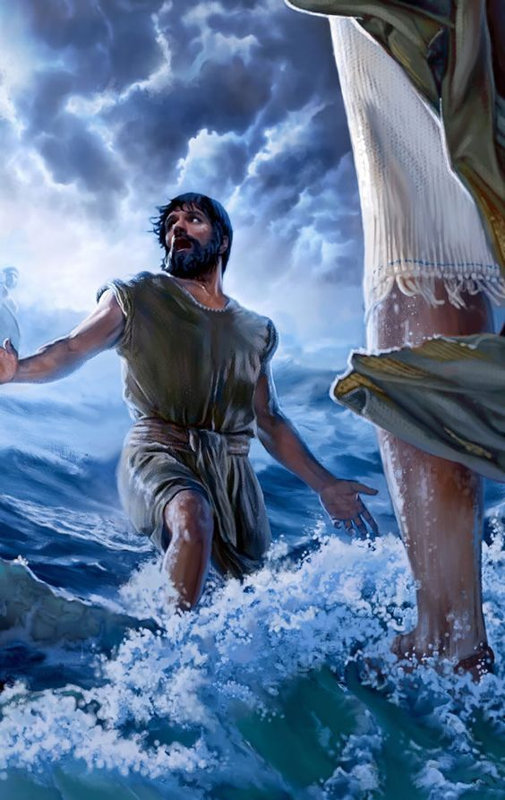
Stay Focused on the Truth I Am the Way, the Truth, and the Life…” - Jesus Christ (John 14:6)
To stay focused on the truth is to stay focused on Christ (John 8:31-32, 17:17).
Doubts are eliminated when we educate ourselves (Psalm 119:105)
In Peter’s account, we see that when we take our eyes off Jesus, we begin to waver (Matthew 14:22-23)
When doubts begin to arise, TAKE HIS HAND and get back to the truth (Hebrews12:1-3)
Notes:
Time and time again, we are reminded in God’s word of the importance of staying focused on Jesus Christ. By calling Himself “the Truth,” He implies that He is the Source of truth. Thus, to stay focused on the truth is to stay focused on Christ and what He has revealed for us to know. He stated in John 8:31-32, “If you abide in My word, you are My disciples indeed. And you shall know the truth, and the truth shall make you free.” Thus, to abide in His word is to know the truth. We also see Christ making this connection in His prayer to God in John 17:17 where He stated, “Thy word is truth.”
Doubts arise when we lack information or when what we have come to know is called into question. They are eliminated when we educate ourselves or, perhaps, remind ourselves of the facts. In describing the word of God, the psalmist said that it is, “a lamp to my feet and a light to my path.” (Psalm 119:105)
The importance of staying focused on Christ is seen in a very literal way in the account we find in Matthew 14:22-23:
“Immediately Jesus made His disciples get into the boat and go before Him to the other side, while He sent the multitudes away. And when He had sent the multitudes away, He went up on the mountain by Himself to pray. Now when evening came, He was alone there. But the boat was now in the middle of the sea, tossed by the waves, for the wind was contrary. Now in the fourth watch of the night Jesus went to them, walking on the sea. And when the disciples saw Him walking on the sea, they were troubled, saying, ‘It is a ghost!’ And they cried out for fear. But immediately Jesus spoke to them, saying, ‘Be of good cheer! It is I; do not be afraid. And Peter answered Him and said, Lord, if it is You, command me to come to You on the water.’ So, He said, ‘Come.’ And when Peter had come down out of the boat, he walked on the water to go to Jesus. But when he saw that the wind was boisterous, he was afraid; and beginning to sink he cried out, saying, ‘Lord, save me!’ And immediately Jesus stretched out His hand and caught him, and said to him, ‘O you of little faith, why did you doubt?’ And when they got into the boat, the wind ceased. Then those who were in the boat came and worshiped Him, saying, ‘Truly You are the Son of God.’ ”
We often give Peter a hard time when referencing this account, failing to remember that he is the only one who had enough faith to get out of the boat in the first place! However, we see his faith wavered when he took his eyes off the Lord. He began to listen, if you will, to the winds and the waves and the laws of nature that were screaming at him with doubts: “Human beings cannot walk on the water!” “This storm is too big for you to handle!” “Look how dark these waters are! What will become of you if you start to sink!?”
The conclusion to this episode perfectly makes the point we are stressing:
When doubts begin to arise… When you feel as though the darkness of skepticism is creeping in all around… When you start to sink into questions that threaten your trust in God…
Take. His. Hand. Get back to the truth. Re-focus yourself on your King.
“Therefore we also, since we are surrounded by so great a cloud of witnesses, let us lay aside every weight, and the sin which so easily ensnares us, and let us run with endurance the race that is set before us, looking unto Jesus, the author and finisher of our faith, who for the joy that was set before Him endured the cross, despising the shame, and has sat down at the right hand of the throne of God. For consider Him who endured such hostility from sinners against Himself, lest you become weary and discouraged in your souls.” (Heb 12:1-3)

Slide 8
Stay Focused on the Truth I Am the Way, the Truth, and the Life…” - Jesus Christ (John 14:6)
“Therefore we also, since we are surrounded by so great a cloud of witnesses, let us lay aside every weight, and the sin which so easily ensnares us, and let us run with endurance the race that is set before us, looking unto Jesus, the author and finisher of our faith, who for the joy that was set before Him endured the cross, despising the shame, and has sat down at the right hand of the throne of God. For consider Him who endured such hostility from sinners against Himself, lest you become weary and discouraged in your souls.” (Heb 12:1-3)
Notes:
Time and time again, we are reminded in God’s word of the importance of staying focused on Jesus Christ. By calling Himself “the Truth,” He implies that He is the Source of truth. Thus, to stay focused on the truth is to stay focused on Christ and what He has revealed for us to know. He stated in John 8:31-32, “If you abide in My word, you are My disciples indeed. And you shall know the truth, and the truth shall make you free.” Thus, to abide in His word is to know the truth. We also see Christ making this connection in His prayer to God in John 17:17 where He stated, “Thy word is truth.”
Doubts arise when we lack information or when what we have come to know is called into question. They are eliminated when we educate ourselves or, perhaps, remind ourselves of the facts. In describing the word of God, the psalmist said that it is, “a lamp to my feet and a light to my path.” (Psalm 119:105)
The importance of staying focused on Christ is seen in a very literal way in the account we find in Matthew 14:22-23:
“Immediately Jesus made His disciples get into the boat and go before Him to the other side, while He sent the multitudes away. And when He had sent the multitudes away, He went up on the mountain by Himself to pray. Now when evening came, He was alone there. But the boat was now in the middle of the sea, tossed by the waves, for the wind was contrary. Now in the fourth watch of the night Jesus went to them, walking on the sea. And when the disciples saw Him walking on the sea, they were troubled, saying, ‘It is a ghost!’ And they cried out for fear. But immediately Jesus spoke to them, saying, ‘Be of good cheer! It is I; do not be afraid. And Peter answered Him and said, Lord, if it is You, command me to come to You on the water.’ So, He said, ‘Come.’ And when Peter had come down out of the boat, he walked on the water to go to Jesus. But when he saw that the wind was boisterous, he was afraid; and beginning to sink he cried out, saying, ‘Lord, save me!’ And immediately Jesus stretched out His hand and caught him, and said to him, ‘O you of little faith, why did you doubt?’ And when they got into the boat, the wind ceased. Then those who were in the boat came and worshiped Him, saying, ‘Truly You are the Son of God.’ ”
We often give Peter a hard time when referencing this account, failing to remember that he is the only one who had enough faith to get out of the boat in the first place! However, we see his faith wavered when he took his eyes off the Lord. He began to listen, if you will, to the winds and the waves and the laws of nature that were screaming at him with doubts: “Human beings cannot walk on the water!” “This storm is too big for you to handle!” “Look how dark these waters are! What will become of you if you start to sink!?”
The conclusion to this episode perfectly makes the point we are stressing:
When doubts begin to arise… When you feel as though the darkness of skepticism is creeping in all around… When you start to sink into questions that threaten your trust in God…
Take. His. Hand. Get back to the truth. Re-focus yourself on your King.
“Therefore we also, since we are surrounded by so great a cloud of witnesses, let us lay aside every weight, and the sin which so easily ensnares us, and let us run with endurance the race that is set before us, looking unto Jesus, the author and finisher of our faith, who for the joy that was set before Him endured the cross, despising the shame, and has sat down at the right hand of the throne of God. For consider Him who endured such hostility from sinners against Himself, lest you become weary and discouraged in your souls.” (Heb 12:1-3)

Slide 9

Can we trust the bible?
• The Bible claims to be from God (2 Tim 3:16-17; 2 Pet 1:20-21; 1 Thess 2:13; 1 Cor 2:13)
The Bible is not a single book. It is a combination of 66 books: 39 that comprise the Old Testament and 27 that comprise the New Testament.
The Bible was written by some 40 different authors. The men who wrote the Bible came from various backgrounds. Some were kings, while others were doctors and fishermen.
The books of the Bible were written over a period of some 1,500 years.
The books of the Bible were not all written originally in the same language. The Old Testament was written in Hebrew and Aramaic. The New Testament was written in Greek.
The Bible is accurate and reliable when it touches upon academic areas such as history, science, and geography.
Notes:
Can we trust the Bible?
It is all well and good to talk about our need to focus on God’s word as the standard of truth, but if we are being honest, a lot of time we find ourselves doubting because of skeptics’ claims that the Bible is merely the work of fallible men; that it is ultimately nothing more than a collection of myths and fables. Please consider the following facts about the Bible that demonstrate its trustworthiness:
The Bible claims to be from God (2 Tim 3:16-17; 2 Pet 1:20-21; 1 Thess 2:13; 1 Cor 2:13)
The Bible is not a single book. It is a combination of 66 books: 39 that comprise the Old Testament and 27 that comprise the New Testament.
The Bible was written by some 40 different authors. The men who wrote the Bible came from various backgrounds. Some were kings, while others were doctors and fishermen.
The books of the Bible were written over a period of some 1,500 years.
The books of the Bible were not all written originally in the same language. The Old Testament was written in Hebrew and Aramaic. The New Testament was written in Greek.
The Bible is accurate and reliable when it touches upon academic areas such as history, science, and geography.
Can you imagine the result we would have today if we took 40 men with varying educations, cultures, backgrounds, and occupations and gave each of them a year to write their thoughts concerning God that would, ultimately, be compiled into one single volume? It would, undoubtedly, be full of conflicting ideas. Yet the books of the Bible fit together perfectly. They form one complete picture and convey one unified message concerning God and His will for mankind.

Slide 10
Christ: The Ultimate Proof “Jesus Christ our Lord…declared to be the Son of God with power…by the resurrection from the dead.” - Paul (Rom 1:3-4)
Jesus Christ rose from the dead (1 Corinthians 15:1-4)
The honest critic will acknowledge that the resurrection is one of the best documented events in history; that the gospel accounts are accurate regarding other historical facts, cultural norms, geography, etc.; and that the gospel writers, therefore, are reliable
The Jews at that time anticipated people trying to explain the resurrection in a non-miraculous way and took steps to prevent such from happening (Matthew 27:62-66)
- They had Pilate seal a heavy stone over the tomb
- They set a guard so no one could sneak the body of Christ out
- The soldiers guarding were highly trained and took their duties to guard prisoners very seriously. If that which they were guarding escaped or was stolen, they understood that it was their life on the line (Acts 12:18-19; 16:25-28)
Notes:
Christ: The Ultimate Proof
“Jesus Christ our Lord…declared to be the Son of God with power…by the resurrection from the dead.” - Paul (Rom 1:3-4)
If we are being honest, a lesson on this subject is not of much help or comfort if we simply talk about the need to stay focused on Jesus and His word while failing to demonstrate that He truly is the Son of God as He claims. Now, we did take some time to demonstrate evidence that the Bible is more than just the product of men (evidence we will add to before the lesson is concluded), but I want to take a moment to talk about how Jesus truly is the ultimate proof for the validity of this book we call the Bible.
One of the main facts regarding the gospel message is that Jesus Christ rose from the dead (cf. 1 Cor 15:1-4). The details of this are contained in each of the gospel accounts (i.e., Matthew, Mark, Luke, and John), and its significance is reiterated repeatedly throughout the remainder of the New Testament. Paul even goes as far as to say that if Jesus did not rise from the grave, then our faith is empty.
“Now if Christ is preached that He has been raised from the dead, how do some among you say that there is no resurrection of the dead? But if there is no resurrection of the dead, then Christ is not risen. And if Christ is not risen, then our preaching is empty, and your faith is also empty. Yes, and we are found false witnesses of God, because we have testified of God that He raised up Christ, whom He did not raise up—if in fact the dead do not rise. For if the dead do not rise, then Christ is not risen. And if Christ is not risen, your faith is futile; you are still in your sins! Then also those who have fallen asleep in Christ have perished. If in this life only we have hope in Christ, we are of all men the most pitiable.” (1 Cor 15:12-19)
Skeptics of the Bible often try to dismiss the resurrection (not surprisingly). If they can disprove Christ’s ultimate miracle, then they effectively discredit Christianity and, subsequently, the Bible as a whole. After all, Jesus quoted from 24 Old Testament books. So, proving Him a fraud not only discredits His teachings in the New Testament, but everything He claimed to be true from the Old Testament as well. Note, however, if we can demonstrate the antithesis, then such validates both Testaments of the Bible! Hence our claim that Jesus, through His resurrection, is the ultimate evidence. It proves our need to remain focused on Him!
The honest critic will acknowledge that the resurrection is one of the best documented events in history; that the gospel accounts are accurate regarding other historical facts, cultural norms, geography, etc.; and that the gospel writers, therefore, are reliable. This does not prevent, however, various theories about how the resurrection could be explained in a non-miraculous way.
Some will say that the disciples created the story to perpetuate their made-up religion. However, it is interesting to note that the Jews at that time anticipated them doing this and took steps to prevent such from happening (Matt 27:62-66). They had Pilate seal a heavy stone over the tomb and set a guard so no one could sneak the body of Christ out and thus perpetuate a hoax! Roman soldiers were no pushovers. They were highly trained and took their duties to guard prisoners very seriously. If that which they were guarding escaped or was stolen, they understood that it was their life on the line (cf. Acts 12:18-19; 16:25-28). The theory that the disciples rolled away the stone and stole the body without these guards noticing is simply improbable. It is interesting to note that after Christ was raised, the soldiers who had been guarding the tomb went to the chief priests and reported what had happened. What were they told to say (Matt 28:11-15)?

Slide 11
Christ: The Ultimate Proof How we know we have proof through Christ
If the disciples were perpetuating a lie and had any belief at all in God, why would they willingly subject themselves to eternal punishment? They would have understood that God does not tolerate liars (Proverbs 6:17)
Why would the disciples willingly subject themselves to torture and untimely death if they were without faith and desiring to create a false religion for their own glory (Acts 7:57-60; 12:1-4)
The disciples had a defeated mentality, showing us the disciples would not have even thought about trying to steal His body (John 20:19, Acts 1:6)
Notes:
If the disciples were perpetuating a lie and had any belief at all in God, why would they willingly subject themselves to eternal punishment? They would have understood that God does not tolerate liars (Prov 6:17)! If they were without faith and desiring to create a false religion for their own glory, why would they willingly subject themselves to torture and untimely death (Acts 7:57-60; 12:1-4)? Further, the Scriptures are not shy about conveying the disciple’s defeated mentality. John 20:19 states, “The same day at evening, being the first day of the week…the doors were shut where the disciples were assembled…for fear of the Jews.” The disciples, even after Christ had been raised, were under the impression that Christ was going to set up an earthly kingdom. When he died, they thought all hope had been lost. After He had risen, Acts 1:6 states, “When they had come together, they asked Him, saying, ‘Lord, will You at this time restore the kingdom to Israel?’ ” Understanding these things is important because it shows us the disciples would not have even thought about trying to steal His body. What good would a dead king be to their hopes of a restored kingdom?

Slide 12
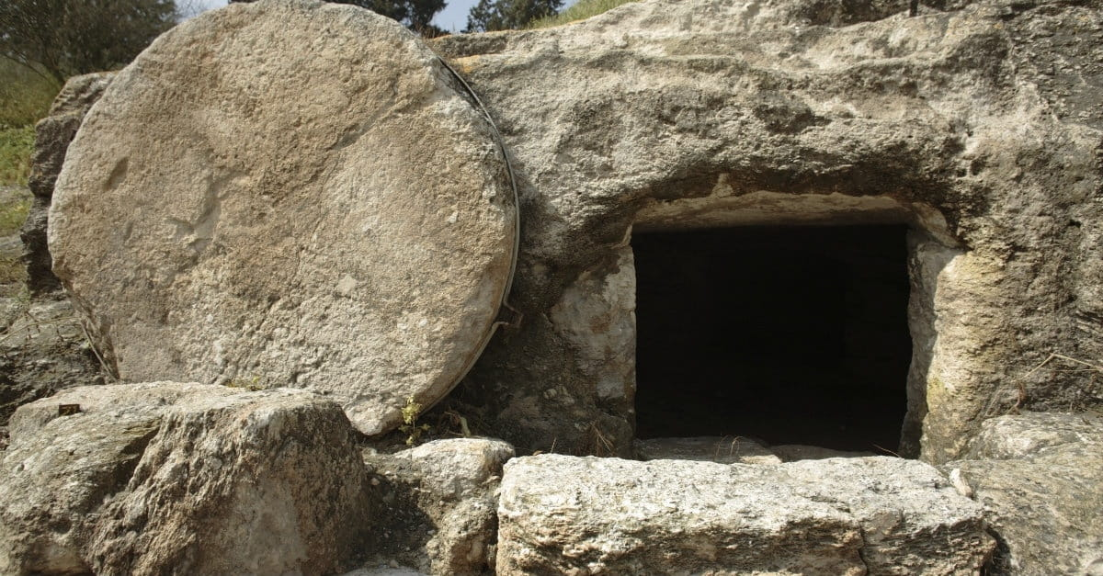
Christ: the ultimate proof
The fact that Christ was truly dead was confirmed by a trained Roman centurion (Mark 15:42-45)
The stone covering the tomb was very large and would require the effort of multiple men to move (Mark 16:1-4)
Even if Christ did not actually die, He would have been weak and helpless after having been beaten, scourged, and crucified (John 19:1-3, Matthew 27:35)
Some will try and teach that Christ was not actually dead when placed into the tomb. Thus, once He awoke, He was able to roll the stone away and escape. The problem with this is two-fold…
Notes:
Some will try and teach that Christ was not actually dead when placed into the tomb. Thus, once He awoke, He was able to roll the stone away and escape. The problem with this is two-fold. First, the fact that Christ was truly dead was confirmed by a trained Roman centurion (Mark 15:42-45). Secondly, the stone covering the tomb was not a mere pebble. We are told it was very large and would require the effort of multiple men to move (Mark 16:1-4). Even if Christ did not actually die, He would have been weak and helpless after having been beaten, scourged, and crucified (John 19:1-3; Matt 27:35). How could one in such a state roll away such a massive stone all by himself?

Slide 13
Christ: the ultimate proof
One final theory puts forth the idea that the eyewitnesses to Christ’s resurrection only had visions of Christ. Thus, while they had good intentions, they were simply mistaken.
The idea of multiple people having the same vision at the same place and time is not plausible (1 Corinthians 15:6)
He appeared to the disciples (Luke 24:36-43)
He proved Himself to be more than a vision or a ghost by eating a meal in their presence and allowing them to touch Him
Notes:
One final theory puts forth the idea that the eyewitnesses to Christ’s resurrection only had visions of Christ. Thus, while they had good intentions, they were simply mistaken. While the idea of one person having a vision or a dream and perceiving it to have been real is somewhat plausible, the idea of multiple people having the same vision at the same place and time is not. In 1 Corinthians 15:6, Paul stated that “He [Christ] was seen by over five hundred brethren at once.” Luke records an occasion where He appeared to the disciples in Luke 24:36-43. At this time, He proved Himself to be more than a vision or a ghost by eating a meal in their presence and allowing them to touch Him. If these individuals were only hallucinating, why, upon their initial preaching of the gospel, did the Jews not simply say, “Wait a minute, we have the body right here!”?
The logical conclusion, upon weighing all the evidence, is that Jesus Christ did indeed rise from the grave proving He is more than just another man. His resurrection proves His claimed identity and the validity of the message He taught. C. S. Lewis once wrote, “A man who was merely a man and said the sort of things Jesus said would not be a great moral teacher. He would either be a lunatic — on the level with the man who says he is a poached egg — or else he would be the Devil of Hell. You must make your choice.” The resurrection of Christ makes this choice clear. It re-enforces the need for us to remain focused on Him and His knowledge as our Guard against doubt.

Slide 14
True Science Confirms the Bible “I don’t know why you always have to be judging me, because I only believe in science.” - Esqueleto (Nacho Libre movie)
At a time when other religions spoke of the earth being supported on the back of a giant creature, the Bible accurately spoke of the earth’s suspension in space. In Job 26:7, it states that God “hangs the earth on nothing.”
Shipbuilders have confirmed that the dimensions given for Noah’s ark in Genesis 6:15 and the verses following, are ideal for a sea-worthy cargo vessel.
Physicians in ancient Egypt and during the Middle Ages often used leeches to remove “bad blood” from sick patients. Patients would often die from such practices. Doctors have since discovered that we need our blood to remain alive. The Bible established the fact that “the life of the flesh is in the blood” in Leviticus 17:11 and 14.
Notes:
True Science Confirms the Bible
“I don’t know why you always have to be judging me, because I only believe in science.” - Esqueleto (Nacho Libre movie)
I am sure you have, at one point or another, been accused of being ignorant, backward, or otherwise anti-science for having expressed your belief in God and/or the Bible. Since we are in the business of eliminating doubt and skepticism in this lesson, I thought it would do us well to demonstrate that true science is not anti-Bible. In fact, true science upholds the Bible! Consider the following sampling of facts:
At a time when other religions spoke of the earth being supported on the back of a giant creature, the Bible accurately spoke of the earth’s suspension in space. In Job 26:7, it states that God “hangs the earth on nothing.”
Shipbuilders have confirmed that the dimensions given for Noah’s ark in Genesis 6:15 and the verses following, are ideal for a sea-worthy cargo vessel.
Physicians in ancient Egypt and during the Middle Ages often used leeches to remove “bad blood” from sick patients. Patients would often die from such practices. Doctors have since discovered that we need our blood to remain alive. The Bible established the fact that “the life of the flesh is in the blood” in Leviticus 17:11 and 14.

Slide 15
True Science Confirms the Bible
Have you ever wondered why a dog and a cat cannot breed to create a hybrid creature? The Bible explains “kinds” of animals in Genesis 1:24.
Before Ferdinand Magellan became the first to sail around the world in the 1500s, the common opinion was that the earth was flat. Oddly enough, some today have also reverted to this erroneous concept despite the overwhelming evidence to the contrary. It is important to note, though, who first identified that the earth is round. The prophet of God wrote in Isaiah 40:22 that God sits “above the circle of the earth.”
Notes:
Have you ever wondered why a dog and a cat cannot breed to create a hybrid creature? The Bible explains “kinds” of animals in Genesis 1:24.
Before Ferdinand Magellan became the first to sail around the world in the 1500s, the common opinion was that the earth was flat. Oddly enough, some today have also reverted to this erroneous concept despite the overwhelming evidence to the contrary. It is important to note, though, who first identified that the earth is round. The prophet of God wrote in Isaiah 40:22 that God sits “above the circle of the earth.”

Slide 16
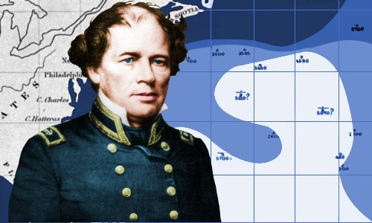
True Science Confirms the Bible
Ocean currents were discovered by Matthew Maury in the 19th century. He was an officer in the United States Navy who decided to figure out what the “paths of the seas” were in Psalm 8:8. He went on to write the first book on Oceanography.
The first law of Thermodynamics states that, in a closed system (such as our universe), there is a set amount of energy. Energy can change states, but such does not affect the actual amount of energy that exists. Why is this? The book of Genesis provides an explanation: (Gen 2:1-2)
The Bible also establishes the second law of Thermodynamics, sometimes referred to as the “law of Entropy.” It is the idea that as energy converts into different forms, the resulting energy is less usable. In other words, things are slowly wearing down. In Psalm 102:26, we read: “They [the heavens and the earth] will all grow old like a garment.”
The man credited with writing down the details of the water cycle, Bernard Palissy, did so in the 16th century. Hundreds of years prior to this, however, Biblical writers wrote very plainly concerning this process (Job 36:27-28, Ecclesiastes 1:7)
The Jet Stream is mentioned by Solomon in Ecclesiastes 1:6
Notes:
The man credited with writing down the details of the water cycle, Bernard Palissy, did so in the 16th century. Hundreds of years prior to this, however, Biblical writers wrote very plainly concerning this process. Note the following two passages: “For He draws up drops of water, which distill as rain from the mist, which the clouds drop down and pour abundantly on man.” (Job 36:27-28) “All the rivers run into the sea, yet the sea is not full; to the place from which the rivers come, there they return again.” (Eccl 1:7)
The Jet Stream is mentioned by Solomon in Ecclesiastes 1:6. There he writes, “The wind goes toward the south, and turns around to the north; the wind whirls about continually and comes again on its circuit.”

Slide 17
True Science Confirms the Bible
The law of Biogenesis states that life cannot come from non-life. Science has demonstrated this time and time again. As such, popular theories such as evolution fail in explaining where life came from because such theories claim that life must, at some point, have arisen via non-living matter. The Bible, though, provides a solution in Genesis chapter one. There we are told that God created life. It is only within such a context that the law of Biogenesis makes sense.
In Leviticus 15:13, washing under “running water” is specified as necessary for a person to be purified or clean. Modern doctors learned this truth the hard way as, for many years, the practice of washing one’s hands in the same bowl of water when dealing with multiple patients caused many untimely deaths.
In Genesis 17:12, we find God’s command to Abraham to circumcise his son on the eighth day. This might seem random at face value, but physicians have confirmed that on the eighth day of a male child’s life, prothrombin and vitamin K are at their highest levels (over 100% – the only time such will occur throughout a male’s lifetime under normal circumstances). These two elements control the body’s ability to coagulate blood. Thus, this is the optimal time for any kind of surgical procedure to be done on a male child.

Slide 18
True Science Confirms the Bible
Sanitation is addressed in Deuteronomy 23:12-13. There it explains the Israelites were to relieve themselves outside of the camp. They were also to carry a small shovel to bury their waste. Many soldiers pre-WWI died from disease rather than injury due to a failure to isolate human waste.
Science has confirmed the human body can be broken down into 28 basic elements. This confirms what the Bible tells us! In Genesis 2:7, we read that God created man from “the dust of the ground.”

Slide 19
True Science Confirms the Bible
Scientific Dating Methods
Light From Distant Heavenly Bodies
This idea is often presented as a Bible slayer because the Bible suggests a very young age for the earth and the universe (roughly 6,000 years – a number ascertained by studying the various genealogies and other time frames recorded in the Scriptures). A scientist dating a rock to be 1.7 million years old, however, need not be a source of doubt for the Christian. Why? Because God created a mature universe. Read Genesis chapter 1. God created an earth with mountains, valleys, rivers, and seas. He created fully mature trees and creatures. He created stars and planets and all the other heavenly bodies with inherent age. If you were able to go back in time and behold the earth on the seventh day, you would observe what would appear to have existed for a very long time.
Since we have been able to test and verify the speed at which light travels upon generation, some have asked, “what about distant starlight?” Given how far we know many stars to be from the earth (again through scientific study), it would follow that for the light from those stars to be visible from the earth, it would take much longer than 6,000 years to get here! Friends, if God could create all we see and experience simply by speaking (cf. Gen 1:3), then He surely could create light in such a state of existence that it had already “travelled” the distance between its source and the earth. (Gen 1:14-15; 2 Tim 3:16-17)
Notes:
Another interesting thought I think is worth discussing relates to the dating methods you often hear cited to suggest the earth is millions of years old. This idea is often presented as a Bible slayer because the Bible suggests a very young age for the earth and the universe (roughly 6,000 years – a number ascertained by studying the various genealogies and other time frames recorded in the Scriptures). A scientist dating a rock to be 1.7 million years old, however, need not be a source of doubt for the Christian. Why? Because God created a mature universe. Read Genesis chapter 1. God created an earth with mountains, valleys, rivers, and seas. He created fully mature trees and creatures. He created stars and planets and all the other heavenly bodies with inherent age. If you were able to go back in time and behold the earth on the seventh day, you would observe what would appear to have existed for a very long time.
This realization, by the way, also solves the “problem” of light from distant heavenly bodies. Since we have been able to test and verify the speed at which light travels upon generation, some have asked, “what about distant starlight?” Given how far we know many stars to be from the earth (again through scientific study), it would follow that for the light from those stars to be visible from the earth, it would take much longer than 6,000 years to get here! Friends, if God could create all we see and experience simply by speaking (cf. Gen 1:3), then He surely could create light in such a state of existence that it had already “travelled” the distance between its source and the earth.
“Then God said, “Let there be lights in the firmament of the heavens to divide the day from the night; and let them be for signs and seasons, and for days and years; and let them be for lights in the firmament of the heavens to give light on the earth”; and it was so.” (Gen 1:14-15; emphasis mine – DCR)
Do not let the enemy convince you that you are against science if you believe in God and His word. Recognize, as we have just done, that true science (not theory or opinion) validates your belief in the Scriptures and He who inspired them to be written (cf. 2 Tim 3:16-17)!

Slide 20

DO NOT BE UNBELIEVING, BUT BELIEVING
“LORD, I BELIEVE; HELP MY UNBELIEF!”
- THE FATHER WHOSE SON WAS POSSESSED OF A DEMON
Everyone doubts!
Doubts of a Christian will come through non-believers and skeptics, or challenges and hardships (Matthew 13:20-21)
“Doubting Thomas” (John 20:24-31)
Just because we did not witness the resurrection of Jesus Christ does not mean we have to doubt Him, because we have other evidence (John 20:31)
Notes:
As we conclude this lesson, it is important to realize everyone doubts. It happens to us all sooner or later. If it does not come through the challenge of non-believers or skeptics, it will come through trials and hardships. Many, sadly, turn their back on God the moment tragedy strikes. Like a plant that springs up in rocky soil, their faith is scorched the moment they face the heat of hardship (cf. Matt 13:20-21). “Why did you do this to me?” they will ask their Creator. “Don’t you care?” Doubt, you see, creeps in. The loss of a loved one is especially trying as most of us know. Even death, though, had its beginnings not with God, but through the deception of our adversary as we had noticed earlier. It is funny how every form of doubt traces back to him, isn’t it?
You may be wondering why we have not talked about Thomas yet? We typically refer to him as “doubting Thomas” after all. Well, I would like to talk about him now for just a moment. In John 20, there was an occasion where the resurrected Lord appeared to all but two of his disciples. Judas had taken his own life (Matt 27:5), and Thomas was otherwise absent.
“Now Thomas, called the Twin, one of the twelve, was not with them when Jesus came. The other disciples therefore said to him, “We have seen the Lord.” So he said to them, “Unless I see in His hands the print of the nails, and put my finger into the print of the nails, and put my hand into His side, I will not believe.” And after eight days His disciples were again inside, and Thomas with them. Jesus came, the doors being shut, and stood in the midst, and said, “Peace to you!” Then He said to Thomas, “Reach your finger here, and look at My hands; and reach your hand here and put it into My side. Do not be unbelieving but believing.” And Thomas answered and said to Him, “My Lord and my God!” Jesus said to him, “Thomas, because you have seen Me, you have believed. Blessed are those who have not seen and yet have believed.” And truly Jesus did many other signs in the presence of His disciples, which are not written in this book; but these are written that you may believe that Jesus is the Christ, the Son of God, and that believing you may have life in His name.” (John 20:24-31)
I always find it remarkable when reading something Jesus said and realizing he had me (and you too) in mind when he said it. Thomas believed because he saw the evidence with his own eyes. Jesus said, “blessed are those who have not seen and yet have believed.” He was referring to you and me, friends! Is Jesus trying to say that we should have a blind faith? God forbid! He was simply saying that we do not have to have been witness to His resurrection with our own eyes to believe in Him. Why? Because we have ample evidence to demonstrate he did indeed rise! Hence, we have what John writes in verse 31: “These are written that you may believe!” In other words, these things were written so you can confidently believe despite not physically having been there!

Slide 21
Conclusion
“This Little Light of Mine.”
Doubt is one of the primary ways Satan tries to “poof” out our lights (cf. Matt 5:14-16).
Mark 9:23, “If you can believe, all things are possible to him who believes.” Keep your eyes on the Lord and He will give you confidence!
“Arise, shine; For your light has come! And the glory of the Lord is risen upon you. For behold, the darkness shall cover the earth, and deep darkness the people; But the Lord will arise over you, and His glory will be seen upon you.” (Isa 60:1-2)
Notes:
One of my favorite songs as a child was “This Little Light of Mine.” One of the reasons I enjoyed it so much was because of the verse that read, “Won’t let Satan “poof” it out, I’m gonna let it shine!” I liked making the “poofing” noise when singing that verse. Doubt is one of the primary ways Satan tries to “poof” out our lights (cf. Matt 5:14-16). It is my prayer this study has and will continue to aid you in not letting Satan be a successful poofer. As Jesus told the father whose words we quoted above in Mark 9, “If you can believe, all things are possible to him who believes” (verse 23). Keep your eyes on the Lord and He will give you confidence!
“Arise, shine; For your light has come! And the glory of the Lord is risen upon you. For behold, the darkness shall cover the earth, and deep darkness the people; But the Lord will arise over you, and His glory will be seen upon you.” (Isa 60:1-2)

Slide 22


